Slide 1

ReportIt: Non-Emergency Reporting App
DESN445 | Final Presentation | Brett Johnson Ryley Goodine

Slide 2
How might we engage a sense of ownership of ETS facilities by riders, so that we can improve ETS ridership, safety, security, and accountability?

Slide 3
Project Explanation
A reporting application for non-emergency situations that is quick and easy to use, while providing a channel for communication between riders and ETS

Slide 4
What we are addressing
Timeline
Engage the rider community to empower personal safety and responsibility
Incorporate the public in the decision making in some capacity
Increase rider interaction — creating a new channel for communication between riders and ETS
Could be implemented within the near future.

Slide 5
Riders
Target Audience
Age 16+
Uses ETS as main source of transportation
Wants to engage with ETS
Wants to improve personal rider experience
What do they need
Timely transit
Clean facilities ( feeling comfortable)
To feel safe
To feel that ETS is actively listening to and dealing with their highlighted issues.

Slide 6
Riders Con’t
How are they feeling
Most riders ignore non-emergency situations and problems
Riders who are engaged are confused about the emergency and non-emergency situations Transit-Watch can deal with, and become frustrated and angry when they use the service and the problem isn’t resolved

Slide 7
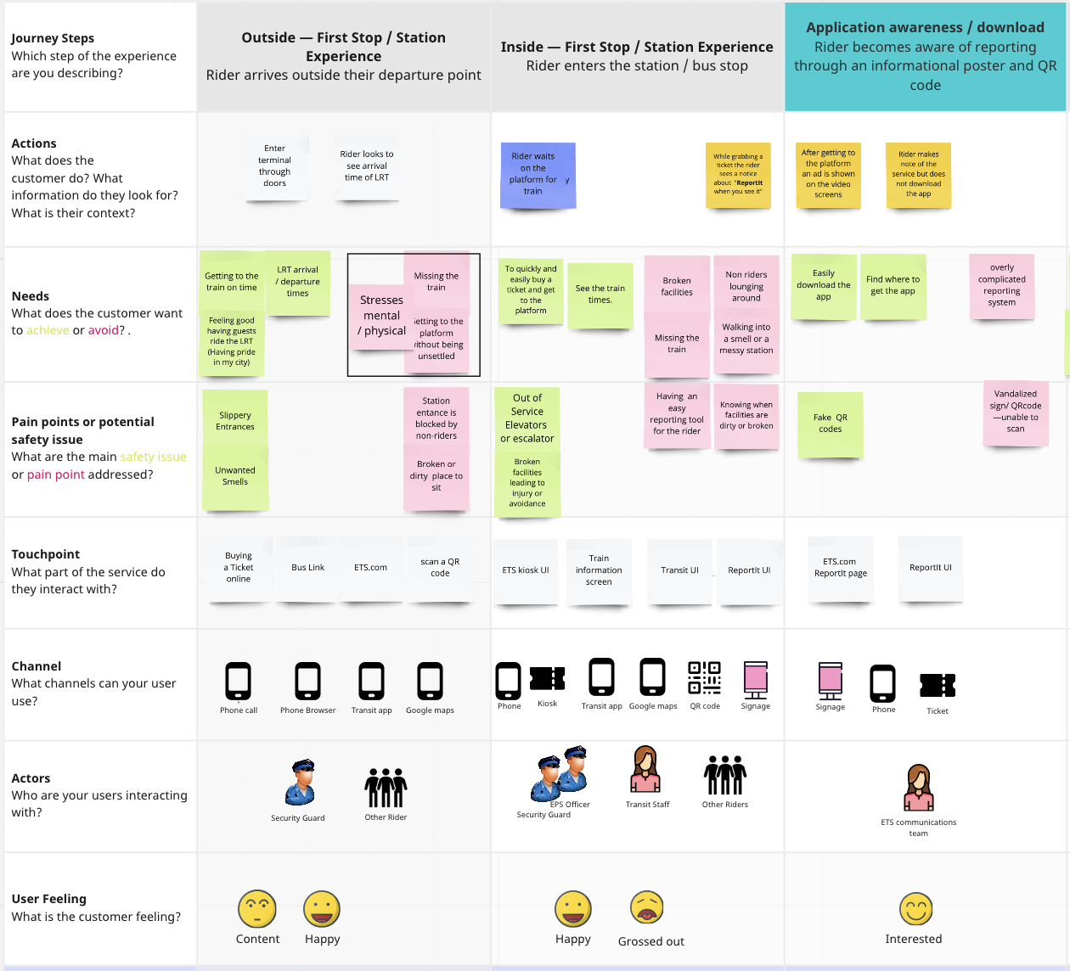
Journey / Scenario
Phase 1 Outside ETS Ecosystem
Physical pain points
Past experiences
ETS
Personal
Phase 2 Enters Ecosystem
Common tasks
Buying ticket
Trip planning etc..
Physical pain points; smell is considered
Phase 3 Application Awareness
Service awareness; includes various touchpoints for QR code
Notes:
Phase 1 - Outside firstop / station experience
User judges ETS facilities from a distance
Manly looking for physical pain points
Access to the facilities
Number of riders occupying the space (bus stop)

Slide 8


Slide 9
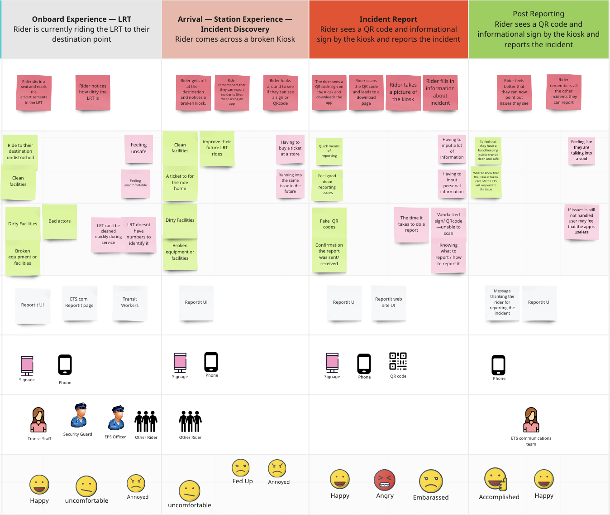
Phase 4 Onboard
Common tasks
Service awareness
Pain Points; repeated or new ones
Phase 5 Arrival
Common tasks
Service awareness
Pain Points; repeated or new ones
Phase 6/7 Report / Follow-up
Easy and quick
Can happen at anytime
Riders get a sense of ownership
Rider needs follow to keep using service

Slide 10
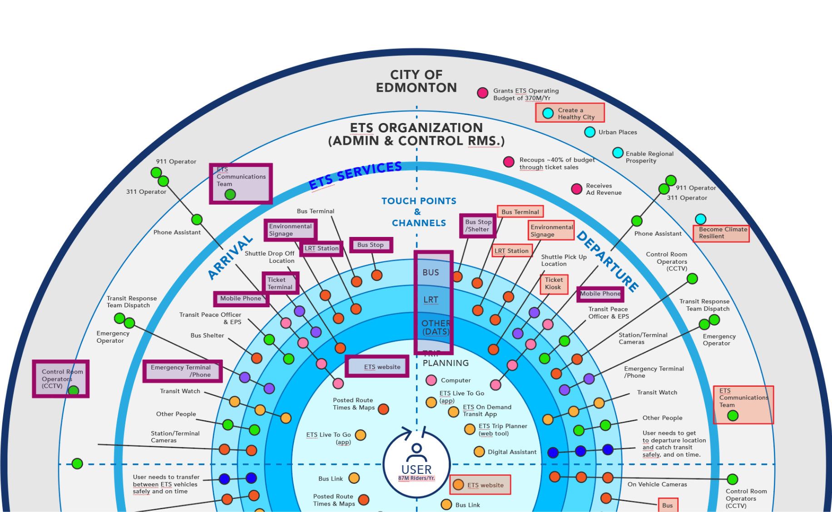
Ecosystem Map Touchpoints
Mobile App
ETS Web App / Website
QR code / Promotional Material
Physical Objects
Digital Screens
Print

Slide 11
Building a solution

Slide 12
Touch Points
ETS website
Informational displays; QRcode
Ticket and ARC Kiosk UI
Transit UI
Physical objects
Ticket validator
Environmental elements (Benchs, doors, etc..)
Bus / LRT operator
Promotional Material
Print
Video
Digital
ReportIt UI
Report received message
Report information Page

Slide 13
User-test / Co-Design Key Takeaways
Riders prioritize reporting dirty facilities and broken accessibility services
Reporting must be fast and easy
No personal information needed
Be available without the need to download application
Notification on receiving and dealing with non-emergency highly recommended; Rider would not use reporting service if they do not see actions from ETS

Slide 14
User-test / Co-Design Key Takeaways Con’t
Reporting would give a sense of “ownership” to the ETS
QR code should be located near or on commonly misused or dirty spaces, objects, services (kiosk - elevator - bathrooms)
Riders did show interest in reporting potencial Community Team matters

Slide 16
Benefits to the city and citizens
Increase public perception of the ETS which could increase ridership (creating security)
Creates sense of ownership for public service; Potentially reducing future incidents
Provides an accessible two-way communication channel between rider and ETS; Rider feels that the ETS is more responsive to their needs

Slide 17
Limits of Project and Potential Future
Limitations
Possible Misuses
User Testing; more UX testing on a variety of riders
Limited information
Deeper knowledge of ETS systems
Greater understanding of ridership
Incentive to use the app
QRcode is replaced (scam / malicious link)
Adding discount system could be abused (creating issues to report)

Slide 18
Limits of Project and Potential Future Con’t
Potential Future
Could be a feature implemented in an ETS app.
Report emergencies involving citizens ( community groups / bad actors)
Possibly create a more responsible mindset in the rider (less litter or issues caused by riders)
Incentive to use design; Gamify and introduce fare discounts

Slide 19
Questions or Comments?

Slide 20
Bibliography
<a href="https://www.vecteezy.com/free-vector/cell-phone">Cell Phone Vectors by Vecteezy</a>
https://miro.com/app/board/uXjVORhpvq8=/
ETS_EcosystemMap_LafranceDominic.ai

